Slide 1
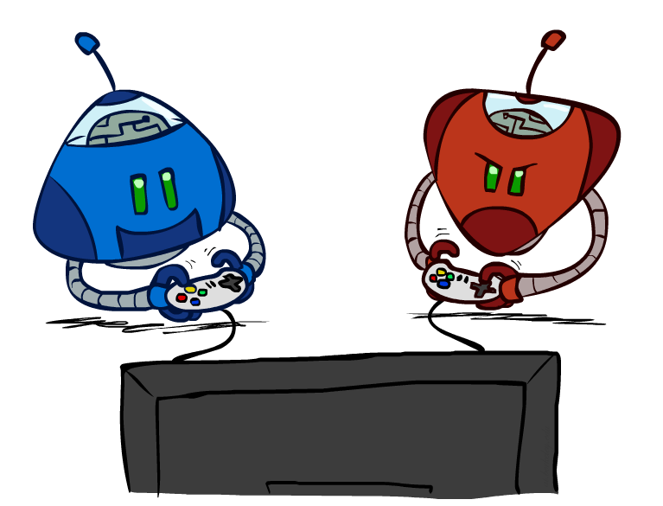
CSC2114: Artificial Intelligence
Adversarial Search
Notes:
Please retain proper attribution and the reference to ai.berkeley.edu. Thanks!

Slide 2
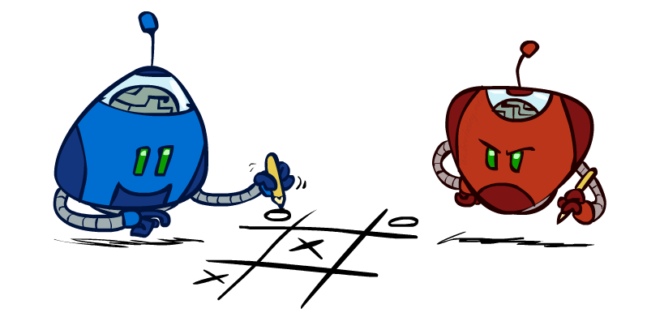
Outline
History / Overview
Minimax for Zero-Sum Games
α-β Pruning
Finite lookahead and evaluation

Slide 3
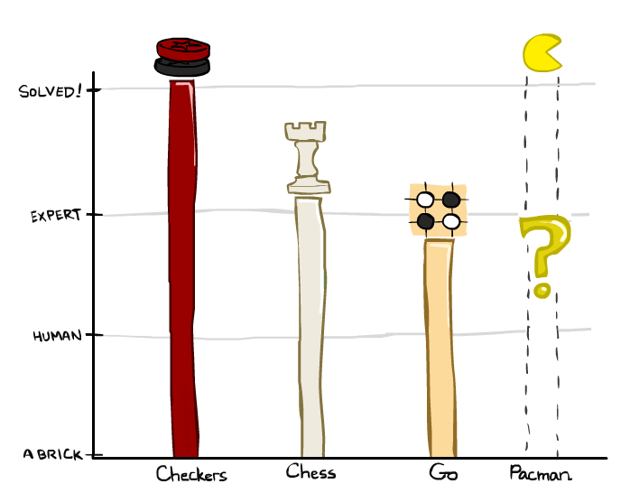

A brief history
Checkers:
1950: First computer player.
1959: Samuel’s self-taught program.
1994: First computer world champion: Chinook defeats Tinsley
2007: Checkers solved! Endgame database of 39 trillion states
Chess:
1945-1960: Zuse, Wiener, Shannon, Turing, Newell & Simon, McCarthy.
1960s onward: gradual improvement under “standard model”
1997: Deep Blue defeats human champion Gary Kasparov
2021: Stockfish rating 3551 (vs 2870 for Magnus Carlsen).
Go:
1968: Zobrist’s program plays legal Go, barely (b>300!)
1968-2005: various ad hoc approaches tried, novice level
2005-2014: Monte Carlo tree search -> strong amateur
2016-2017: AlphaGo defeats human world champions
Pacman
Notes:
Tinsley lost only 5 games to humans in 42 years; has been known to solve 60-ply problems

Slide 4
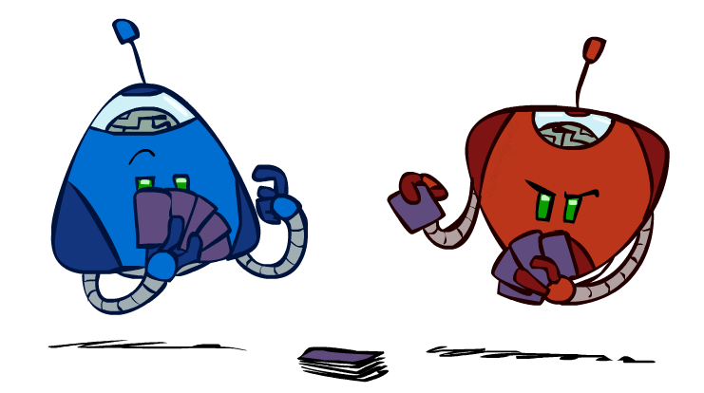
Types of Games
Game = task environment with > 1 agent
Axes:
Deterministic or stochastic?
Perfect information (fully observable)?
One, two, or more players?
Turn-taking or simultaneous?
Zero sum?
Want algorithms for calculating a contingent plan (a.k.a. strategy or policy) which recommends a move for every possible eventuality

Slide 5
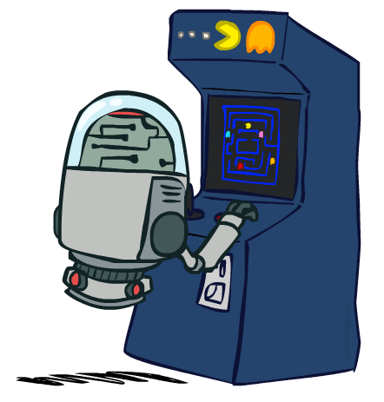
“Standard” Games
Standard games are deterministic, observable, two-player, turn-taking, zero-sum
Game formulation:
Initial state: s₀
Players: Player(s) indicates whose move it is
Actions: Actions(s) for player on move
Transition model: Result(s,a)
Terminal test: Terminal-Test(s)
Terminal values: Utility(s,p) for player p
Or just Utility(s) for player making the decision at root

Slide 6
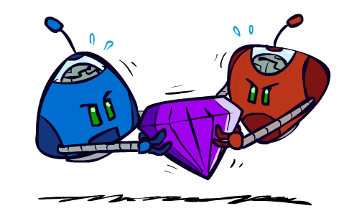
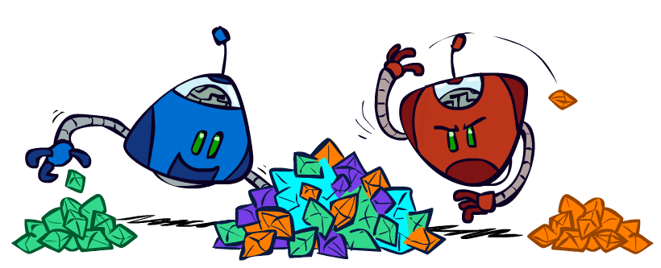
Zero-Sum Games
Zero-Sum Games
Agents have opposite utilities
Pure competition:
One maximizes, the other minimizes
General Games
Agents have independent utilities
Cooperation, indifference, competition, shifting alliances, and more are all possible

Slide 7
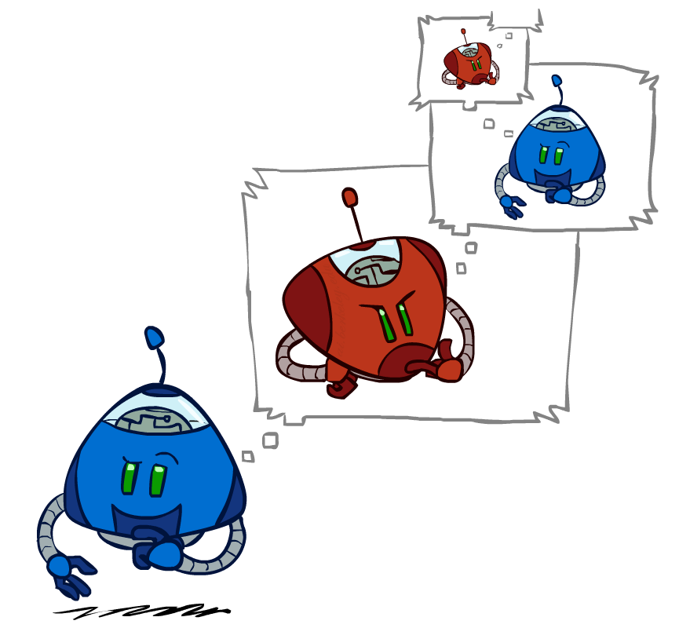
Adversarial Search

Slide 8
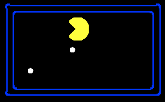
Single-Agent Trees
8
2
0
…
2
6
…
4
6
Notes:
10 points for eating dot; -1 for each time step

Slide 9
Value of a State
Value of a state: The best achievable outcome (utility) from that state
Non-Terminal States:
V(s) = max V(s’)
s’ ∈ successors(s)
8
2
0
…
2
6
…
4
6
Terminal States:
V(s) = known

Slide 10

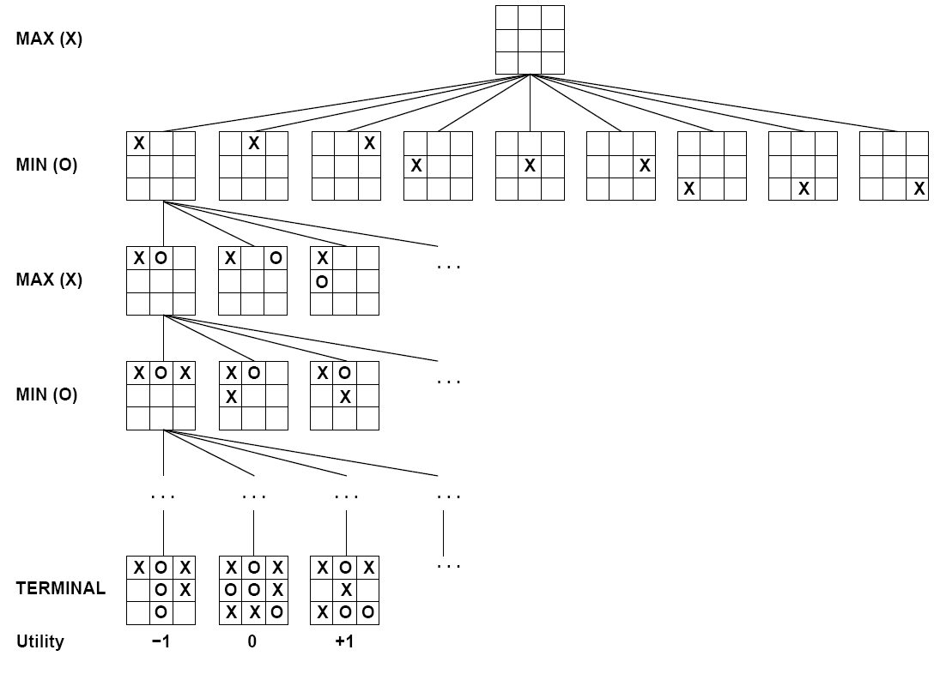

Tic-Tac-Toe Game Tree

Slide 11

Minimax Values
MAX nodes: under Agent’s control
V(s) = max V(s’)
MIN nodes: under Opponent’s control
V(s) = min V(s’)
s’ ∈ successors(s)
s’ ∈ successors(s)
-8
-8
-10
-8
-5
-10
+8
Terminal States:
V(s) = known

Slide 12
Minimax algorithm
Choose action leading to state with best minimax value
Assumes all future moves will be optimal
=> rational against a rational player

Slide 13
Implementation
function minimax-decision(s) returns an action
return the action a in Actions(s) with the highest minimax_value(Result(s,a))
function minimax_value(s) returns a value
if Terminal-Test(s) then return Utility(s)
if Player(s) = MAX then return max_{a in Actions(s)} minimax_value(Result(s,a))
if Player(s) = MIN then return min_{a in Actions(s)} minimax_value(Result(s,a))

Slide 14



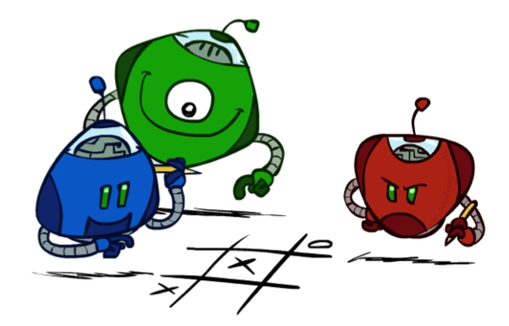
Generalized minimax
What if the game is not zero-sum, or has multiple players?
Generalization of minimax:
Terminals have utility tuples
Node values are also utility tuples
Each player maximizes its own component
Can give rise to cooperation and
competition dynamically…
8,8,1
8,8,1
7,7,2
0,0,7
8,8,1
7,7,2
0,0,8
1,1,6
0,0,7
9,9,0
8,8,1
9,9,0
7,7,2
0,0,8
0,0,7
Notes:
If both ghosts go the same way, pacman wins; if they go different ways, pacman loses

Slide 15
Minimax Efficiency
How efficient is minimax?
Just like (exhaustive) DFS
Time: O(b^{m})
Space: O(bm)
Example: For chess, b ≈ 35, m ≈ 100
Exact solution is completely infeasible
Humans can’t do this either, so how do we play chess?

Slide 16
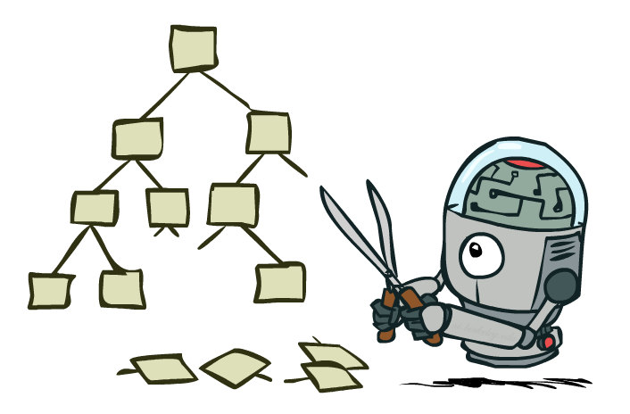
Game Tree Pruning

Slide 17
Minimax Example
3
3
2
2
3
12
8
2
4
6
14
5
2
Notes:
Add values by hand if on tablet, or add by animation steps

Slide 18
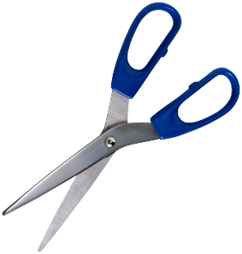
Alpha-Beta Example
α = best option so far from any
MAX node on this path
3
α =3
α =3
3
3
12
8
2
14
5
2
The order of generation matters: more pruning
is possible if good moves come first
Notes:
Add values by hand if on tablet, or add by animation steps

Slide 19
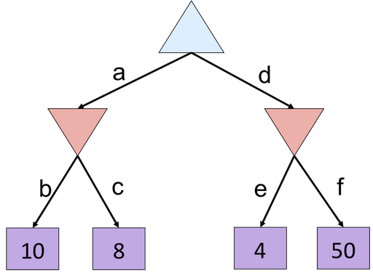
Alpha-Beta Quiz
Notes:
f is not evaluated

Slide 20
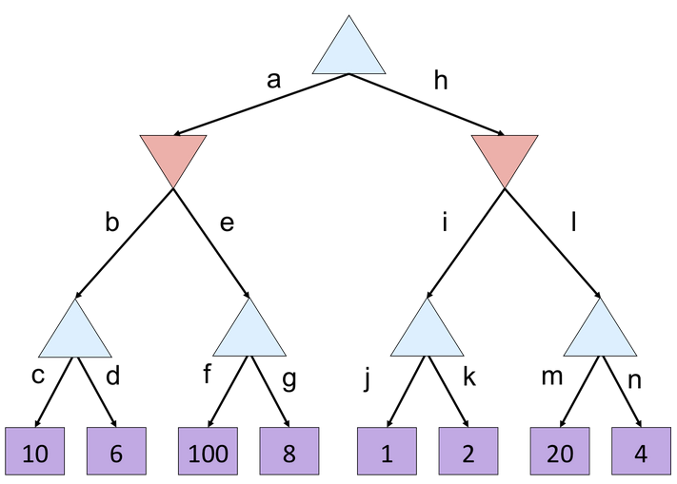
Alpha-Beta Quiz 2

Slide 21
Alpha-Beta Quiz 2
α =
10
?
β =
10
β =
2
?
?
1
2
α=
α=
10
α=
100
?
?
?

Slide 22
Alpha-Beta Pruning
General case (pruning children of MIN node)
We’re computing the MIN-VALUE at some node n
We’re looping over n’s children
n’s estimate of the childrens’ min is dropping
Who cares about n’s value? MAX
Let α be the best value that MAX can get so far at any choice point along the current path from the root
If n becomes worse than α, MAX will avoid it, so we can prune n’s other children (it’s already bad enough that it won’t be played)
Pruning children of MAX node is symmetric
Let β be the best value that MIN can get so far at any choice point along the current path from the root
MAX
MIN
a
MAX
MIN
n

Slide 23
Alpha-Beta Implementation
α: MAX’s best option on path to root
β: MIN’s best option on path to root
def max-value(state, α, β):
initialize v = -∞
for each successor of state:
v = max(v, value(successor, α, β))
if v ≥ β
return v
α = max(α, v)
return v
def min-value(state , α, β):
initialize v = +∞
for each successor of state:
v = min(v, value(successor, α, β))
if v ≤ α
return v
β = min(β, v)
return v
Notes:
Pick an order for two reasons: sequential processor and pruning

Slide 24
Alpha-Beta Pruning Properties
Theorem: This pruning has no effect on minimax value computed for the root!
Good child ordering improves effectiveness of pruning
Iterative deepening helps with this
With “perfect ordering”:
Time complexity drops to O(b^{m/2})
Doubles solvable depth!
This is a simple example of metareasoning (reasoning about reasoning)
For chess: only 35⁵⁰ instead of 35¹⁰⁰!! Yaaay!!!!!
max
min
10
10
0

Slide 25
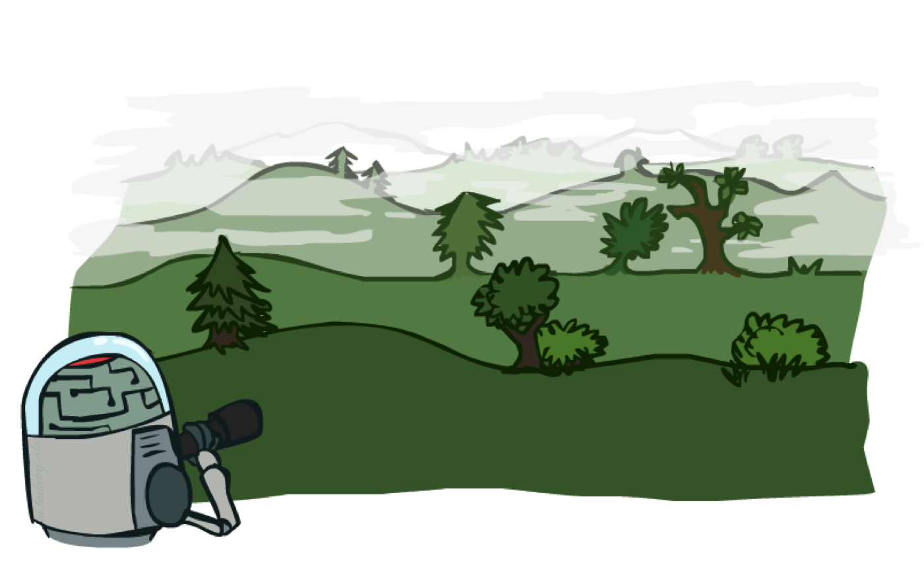
Resource Limits

Slide 26
Resource Limits
Problem: In realistic games, cannot search to leaves!
Solution 1: Bounded lookahead
Search only to a preset depth limit or horizon
Use an evaluation function for non-terminal positions
Guarantee of optimal play is gone
More plies make a BIG difference
Example:
Suppose we have 100 seconds, can explore 10K nodes / sec
So can check 1M nodes per move
Chess with alpha-beta, 35^{(8/2)} =~ 1M; depth 8 is good
max
4
-2
4
min
-1
-2
4
9
?
?
?
?

Slide 27
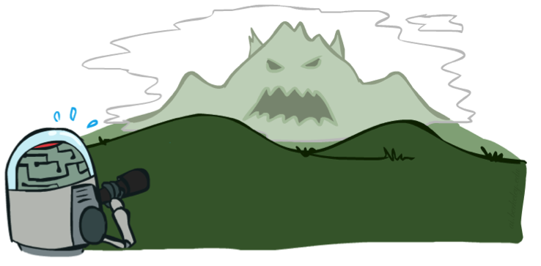

Depth Matters
Evaluation functions are always imperfect
Deeper search => better play (usually)
Or, deeper search gives same quality of play with a less accurate evaluation function
An important example of the tradeoff between complexity of features and complexity of computation
[Demo: depth limited (L6D4, L6D5)]

Slide 28
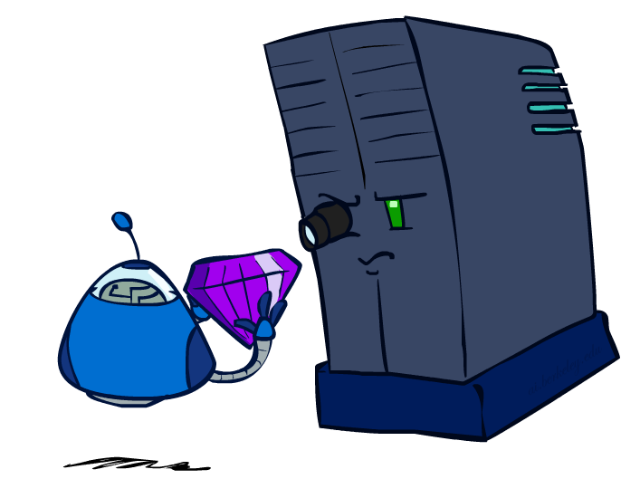
Evaluation Functions

Slide 29
Evaluation Functions
Evaluation functions score non-terminals in depth-limited search
Typically weighted linear sum of features:
EVAL(s) = w₁ f₁(s) + w₂ f₂(s) + …. + w_{n} f_{n}(s)
E.g., w₁ = 9, f₁(s) = (num white queens – num black queens), etc.
Or a more complex nonlinear function (e.g., NN) trained by self-play RL
Terminate search only in quiescent positions, i.e., no major
changes expected in feature values

Slide 30
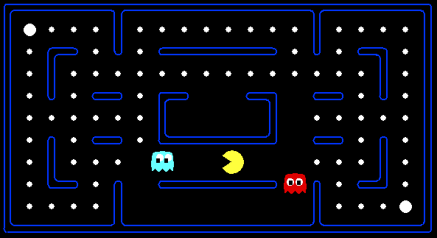

Evaluation for Pacman

Slide 31
Generalized minimax
What if the game is not zero-sum, or has multiple players?
Generalization of minimax:
Terminals have utility tuples
Node values are also utility tuples
Each player maximizes its own component
Can give rise to cooperation and
competition dynamically…
8,8,1
8,8,1
7,7,2
0,0,7
8,8,1
7,7,2
0,0,8
1,1,6
0,0,7
9,9,0
8,8,1
9,9,0
7,7,2
0,0,8
0,0,7
Notes:
If both ghosts go the same way, pacman wins; if they go different ways, pacman loses

Slide 32
Summary
Games require decisions when optimality is impossible
Bounded-depth search and approximate evaluation functions
Games force efficient use of computation
Alpha-beta pruning
Game playing has produced important research ideas
Reinforcement learning (checkers)
Iterative deepening (chess)
Rational metareasoning (Othello)
Monte Carlo tree search (Go)
Solution methods for partial-information games in economics (poker)
Video games present much greater challenges – lots to do!
b = 10⁵⁰⁰, |S| = 10⁴⁰⁰⁰, m = 10,000

